Slide 1

MEC 2025 Team Automation

Slide 2



Our Team
Erin Ng
4th Year Automation Engineering
Bachelor of Technology
Calvin Wong
4th Year Automation Engineering
Bachelor of Technology
Sajib Osman
4th Year Automation Engineering
Bachelor of Technology
Notes:
Member name, program degree and year

Slide 3
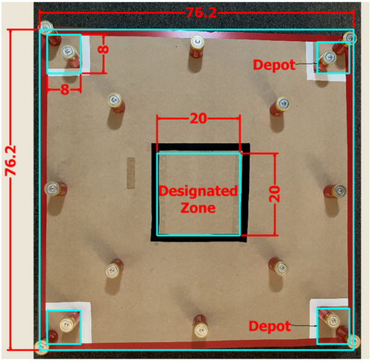
The Problem
Note: All measurements are in cm
Reference: MEC 2025 Competition Package Template - Sr Design.pdf (2025, November 9)
Notes:
MEC 2025 Competition Package Template - Sr Design. (2025, November 9).

Slide 4
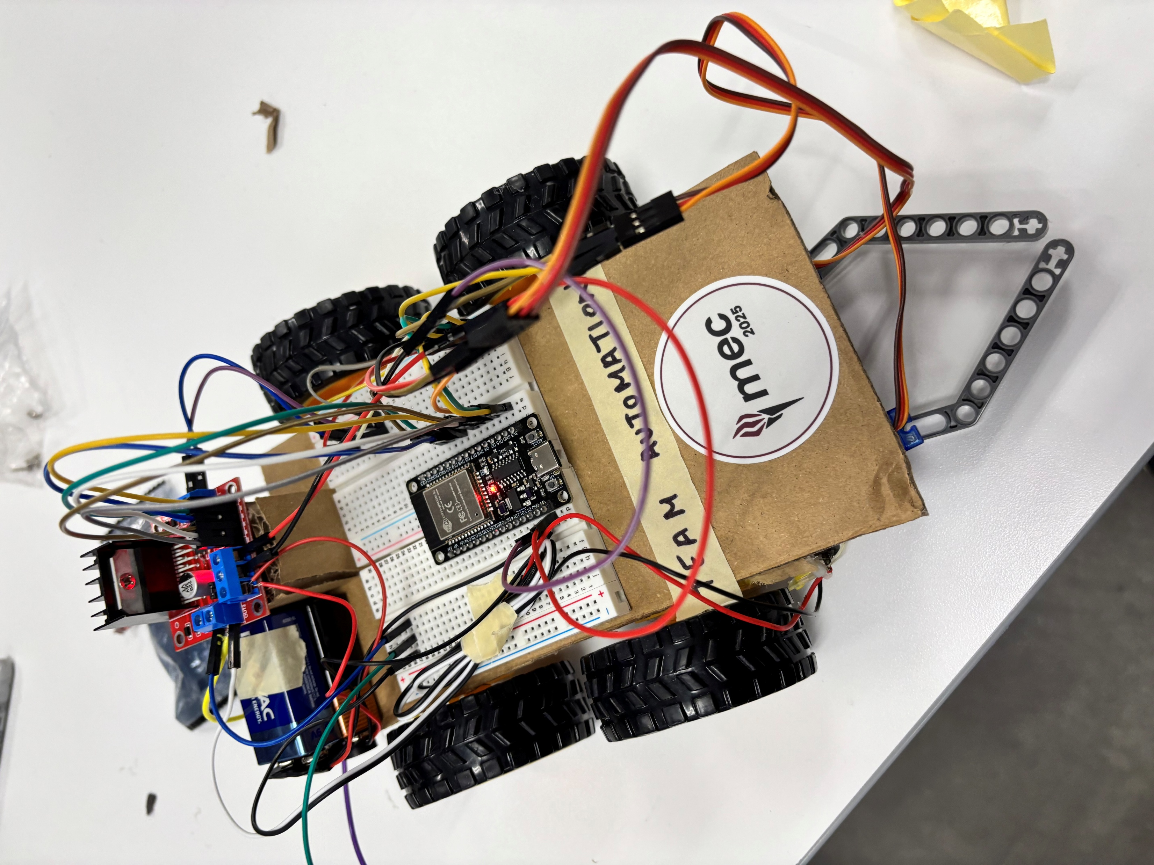
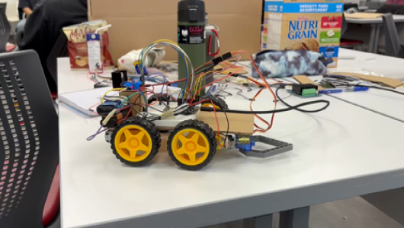
The Solution

Slide 5
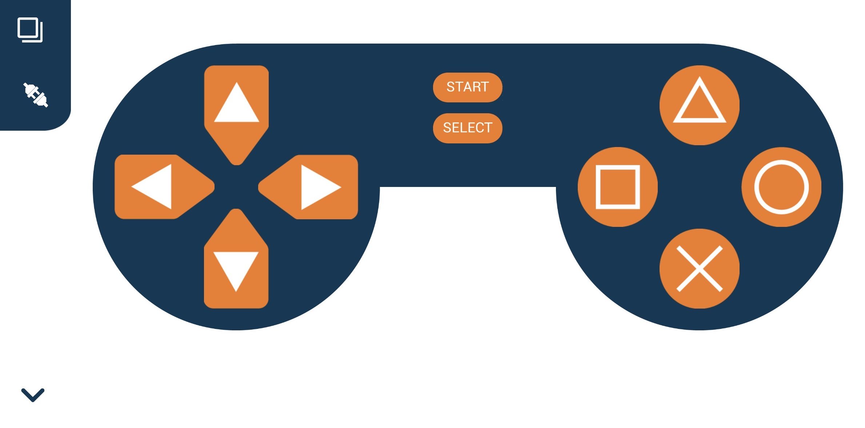
Key Components
Physical layer
4 DC motors
2 Servo motors
2 9V batteries
Motor Controller(L298N)
Control layer
Microcontroller: Esp32
Communication layer
Bluetooth
User Interaction layer
Dabble mobile app
Notes:
Reference: un0038998. (n.d.). UN0038998/esp32_bluetooth_car: This repository contains code and diagram for ESP32 bluetooth car. GitHub. https://github.com/un0038998/ESP32_Bluetooth_Car
https://youtu.be/rSCy1_GbC0w?si=AKxgmDmruM5ZYjkc

Slide 6
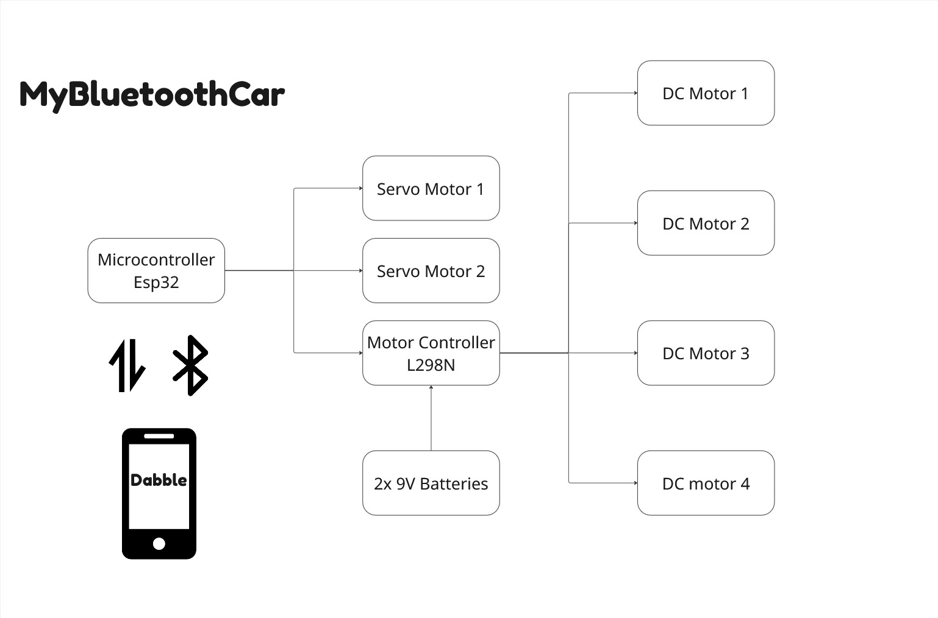
Key Components(cont.)
Physical layer
4 DC motors
2 Servo motors
2 9V batteries
Motor Controller(L298N)
Control layer
Microcontroller: Esp32
Communication layer
Bluetooth
User Interaction layer
Dabble mobile app

Slide 7
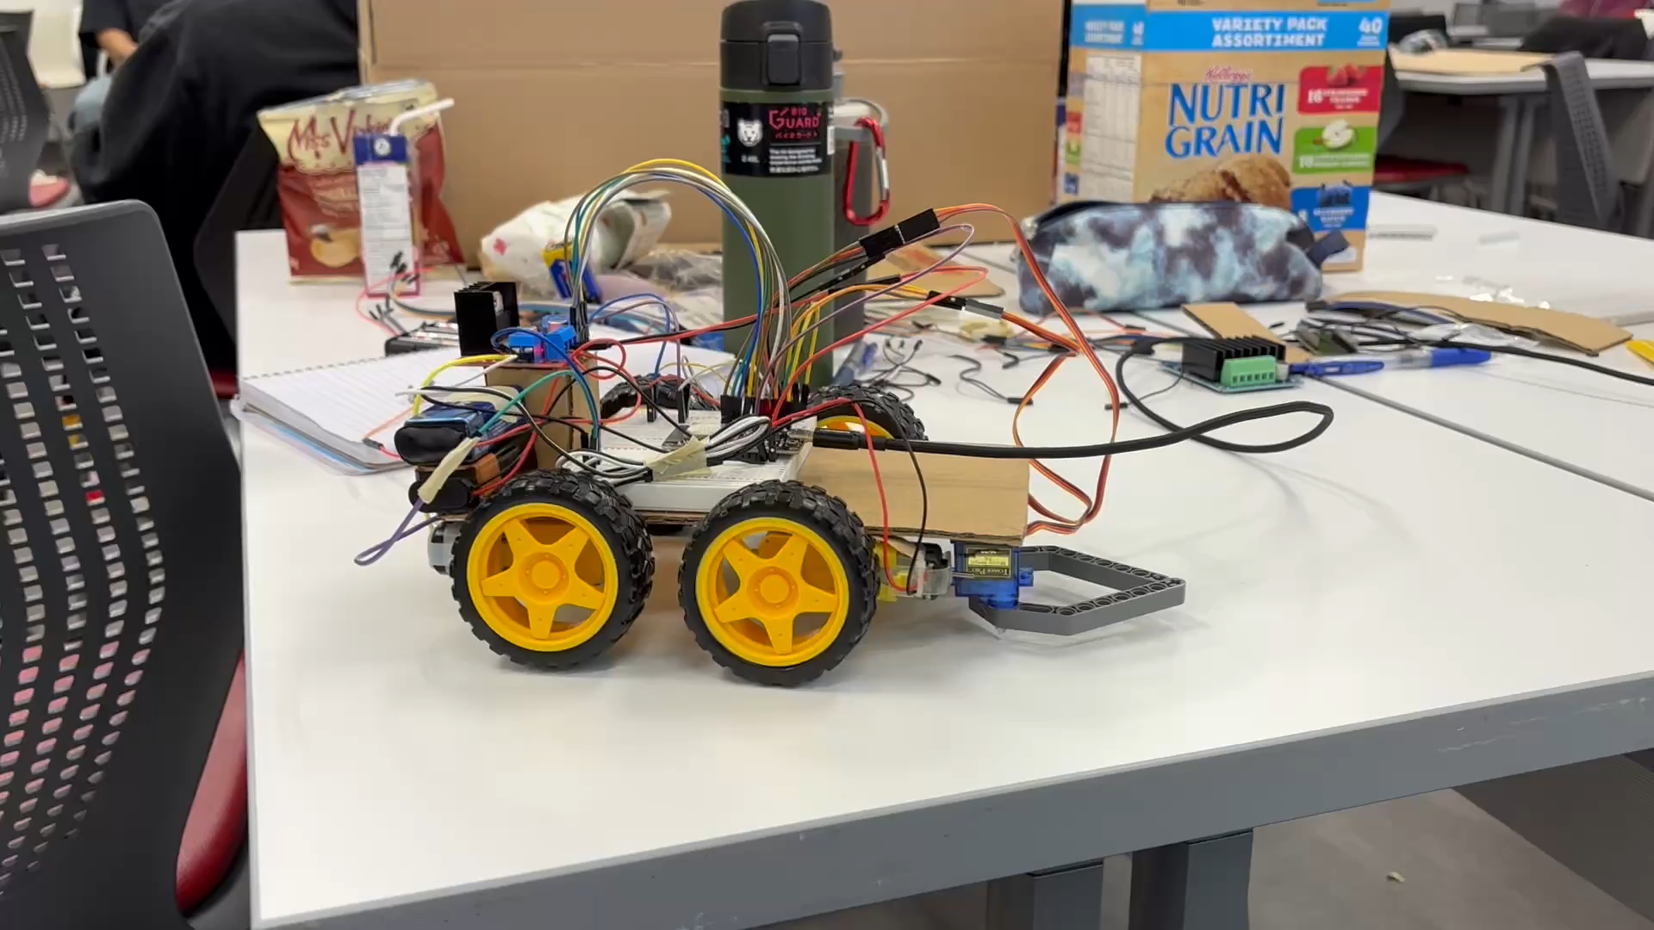
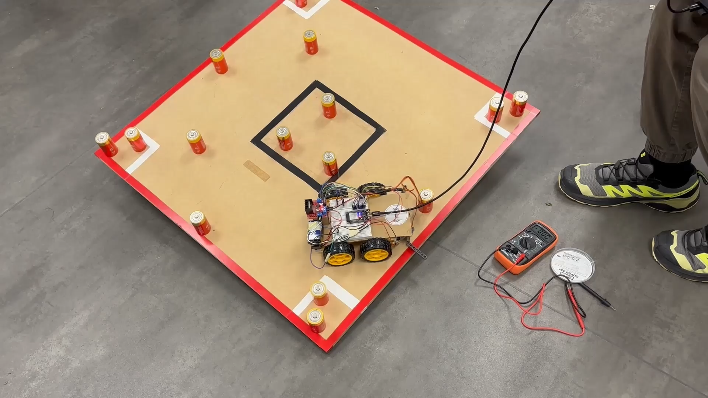
Prototype operation

Slide 8
Strengths and Weaknesses
Strengths
Highly remote
Lightweight
User friendly
Weaknesses
Inefficient(can only carry an object at a time)
Energy consuming
Requires advanced operating skills when it comes to uneven surface

Slide 9
Industrial solution
Mechanical
Using aluminium/composite chassis
Weather-sealed frame (IP54–IP67 depending on use)
Shock mounted electronics
Brushless motors
Metal gear servos
Electrical
Custom PCB
Sensors
Ultrasonic/ToF
Camera/ LiDAR
Control and Safety
PID motion control
RTOS (FreeRTOS, Zephyr)
Notes:
Industrial solution is where you point out further Improvement for recommendations to improve the system.
Mechanical
Aluminium/composite chassis enhances materials(vs cardboard)
Avoids material degradation
Protects sensitive components(MCUs, sensors, batteries, PCBs) from vibration, drops, and impact—critical in disaster-response robots.
Electrical
- Custom PCB to incorporate all electrical components in a place
Sensors
ToF and ultrasonic To track the space between the object and the prototype
Camera and LIDAR sensors are more advanced sensors to track multiple objects
Control and Safety(software components)
PID control for motion adjustments (motor resistance)
RTOS motor and sensor control through a software

Slide 10
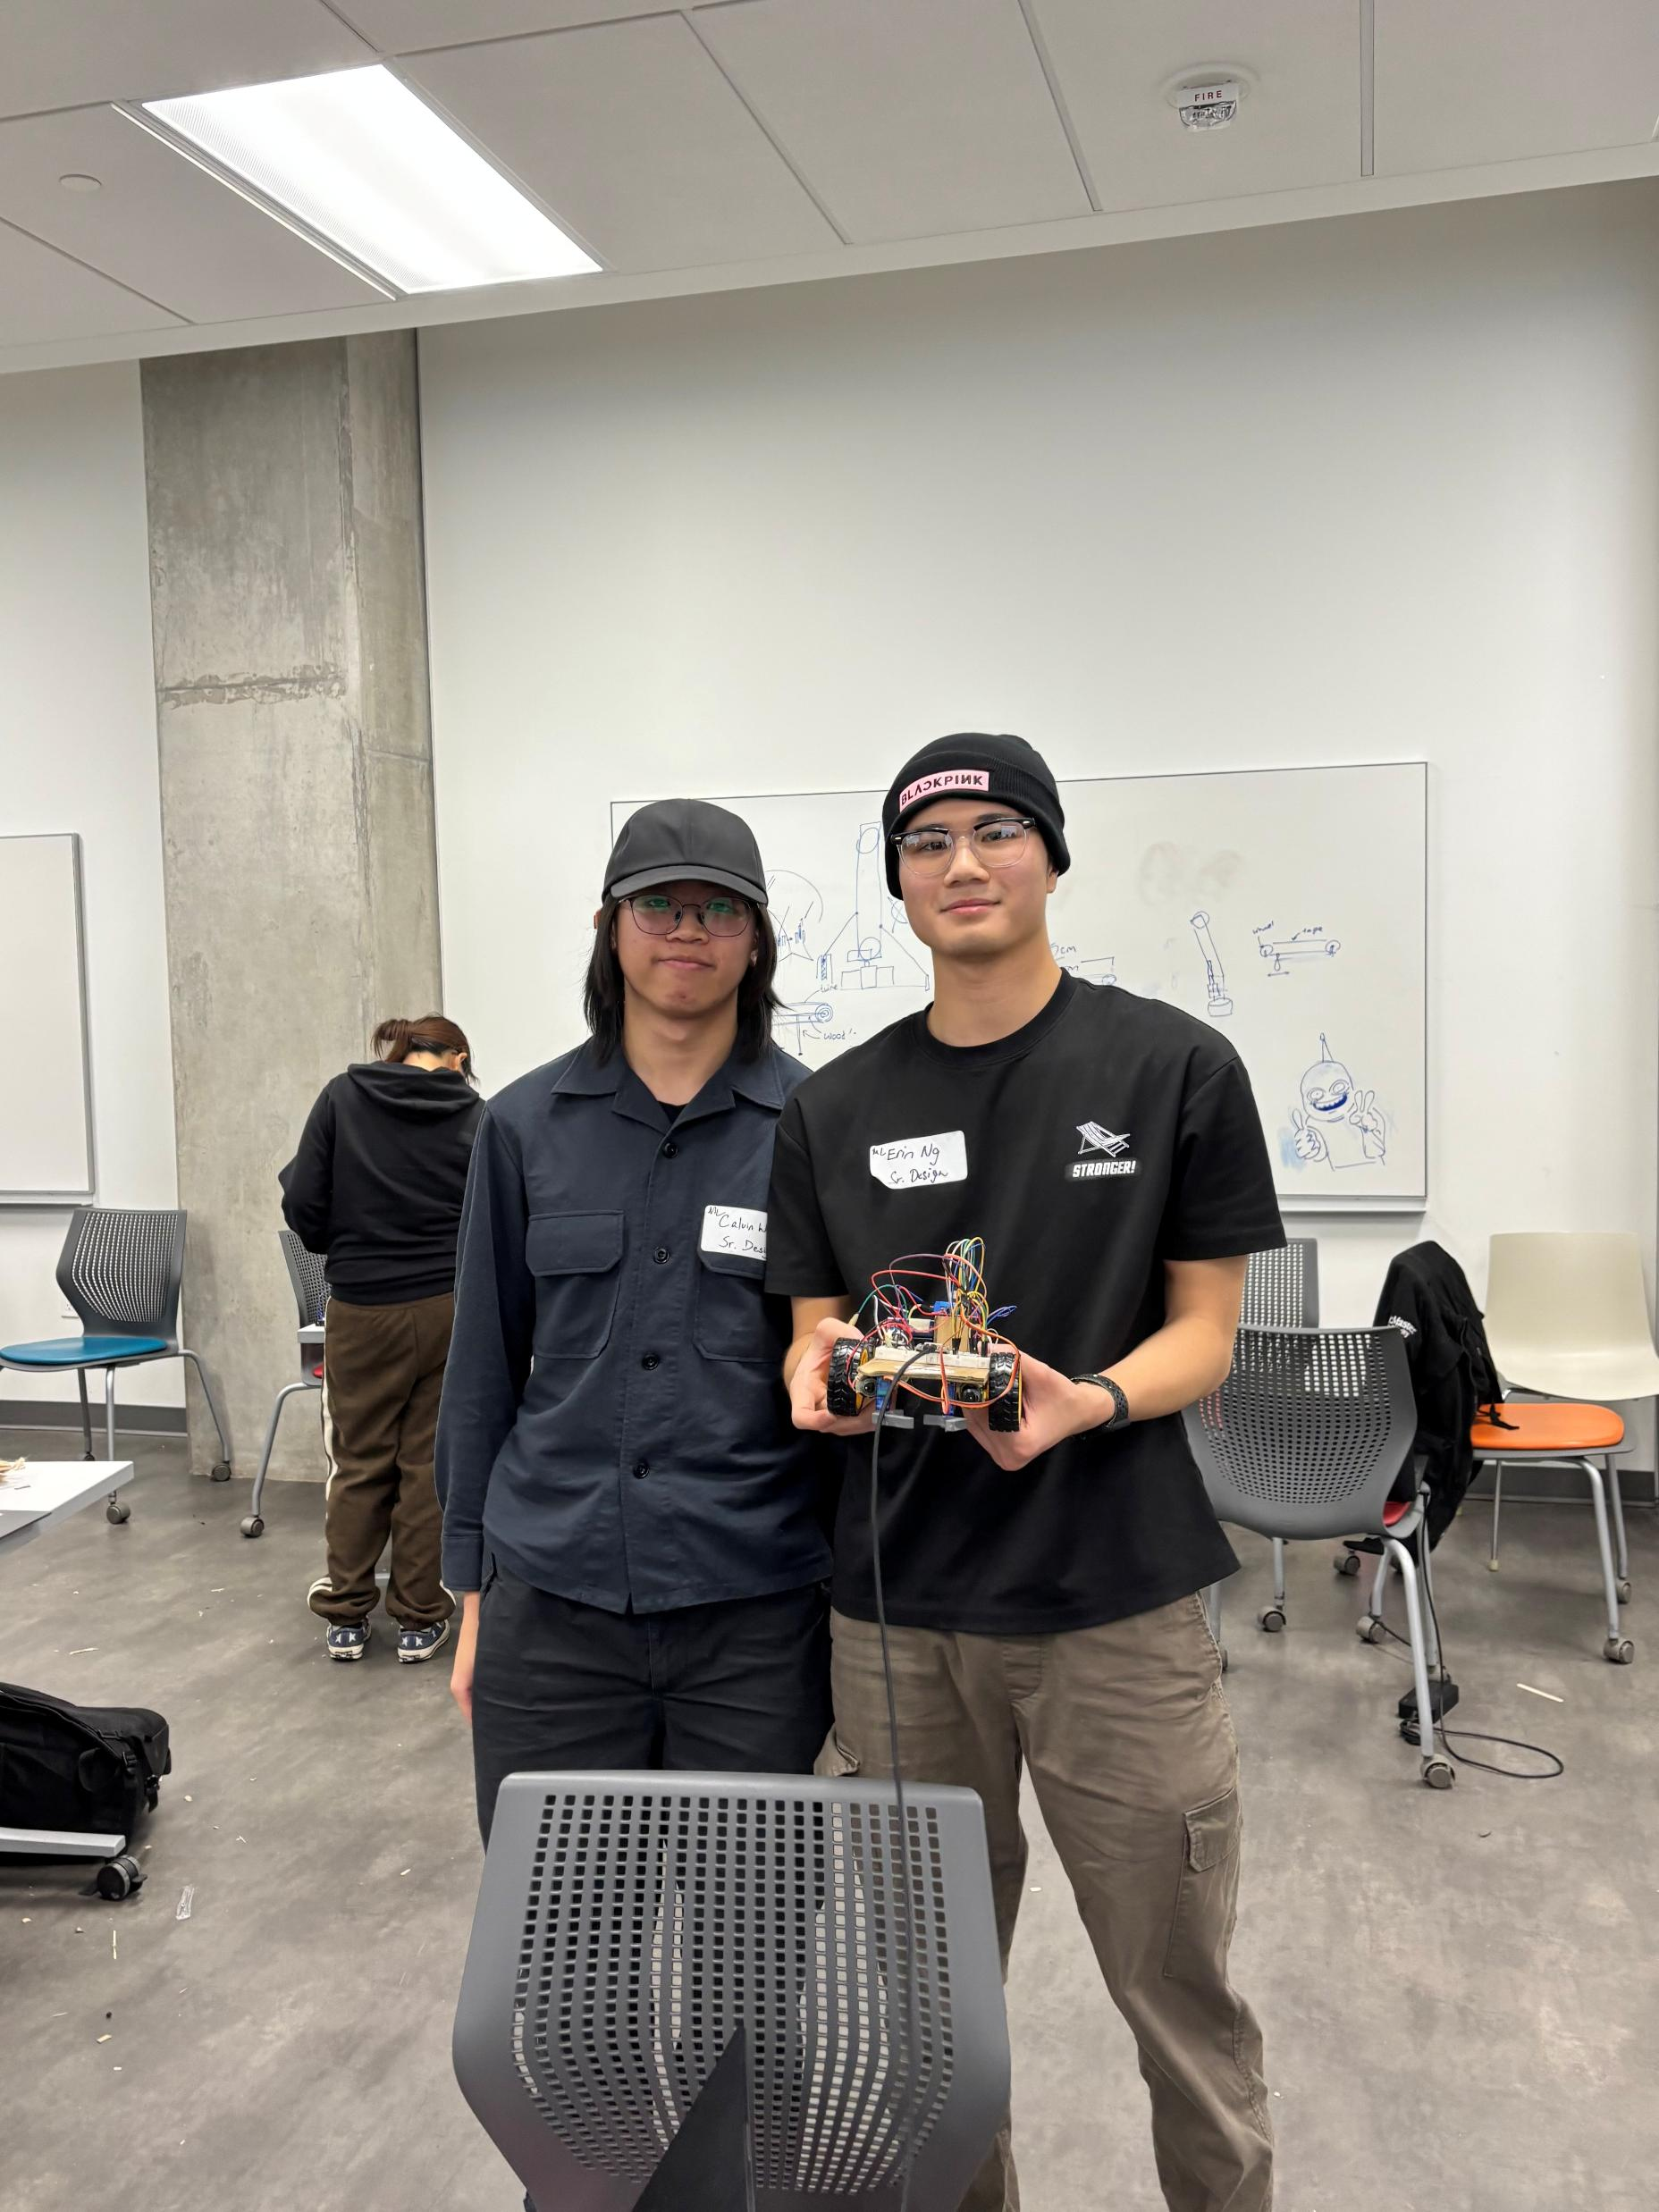
Thank you for your attention
Team Automation

